Slide 1

Black Swan
The Impact of COVID-19 on Taxi Drivers and Customers of Chicago
Chicago | June 21, 2020

Slide 2

Agenda
Hypotheses & Research Questions
Conclusions & Recommendations
Introduction
Analysis & Prediction

Slide 3
Executive Summary
Chicago and its communities is facing unprecedented challenges due to the economic fallout from COVID-19. Social distancing has necessitated a dramatically reduced taxi ridership compared to previous years. This has left the taxi companies, drivers, and their families far below their expected revenue, a trend which is going to continue in coming months
We have conducted a research, analyzing taxi rides data, which allowed us to understand the big picture of the crisis and a dramatic decrease of revenues in the industry, and developed recommendations to interested parties ​
We expect that this analysis allow the different stakeholders to develop mitigation mechanisms and allocate financial resources, while considering both policy objectives and the shareholder expectations ​
For our research we used data from Chicago Open Data Portal and conducted the exploratory data analysis together with building predictive models for further recommendations

Slide 4



Business Case
Client: Working group of Chicago Mayor’s Office, Chicago Taxi Union, taxi companies, Chicago CDO
Problem: estimate the effect of COVID-19 on Chicago taxi drivers, taxi companies, and taxi clients
Deliverable: Research about the effect of COVID-19
on Chicago financial well-being and mobility

Slide 5



Data & Source
Time period: Taxi trips in Chicago (12/2019 – 06/2020)
Size: 4137294 rows * 23 columns (50 taxi companies)
Source: Chicago Open Data Portal

Slide 6
Hypotheses & Research Questions
Conclusions & Recommendations
Introduction
Analysis & Prediction

Slide 7

Research Hypotheses
Hypothesis 1: COVID-19 negatively affected the financial well-being of Chicago cab drivers and their families, as well as revenues of taxi companies
Hypothesis 2: COVID-19 changed the behavior of Chicago taxi clients

Slide 8

Research questions
Changes in rides frequency
Total
by Company
Changes in clients' payments
Payment amount (average fare & total revenue)
Changes in tipping behavior
Changes in mobility
Duration
Mileage
Hours of use
Changes in hotspots

Slide 9
Hypotheses & Research Questions
Conclusions & Recommendations
Introduction
Analysis & Prediction

Slide 10



Hypothesis 1
COVID-19 negatively affected the financial well-being of Chicago cab drivers and their families, as well as revenues of taxi companies
Info: In Chicago, cab drivers are licensed as chauffeurs (~12,700 licenses)
Info: Average salary is $38,001, but the range typically falls between $31,564 and $46,379. Some lease cabs for $500 per week

Slide 11
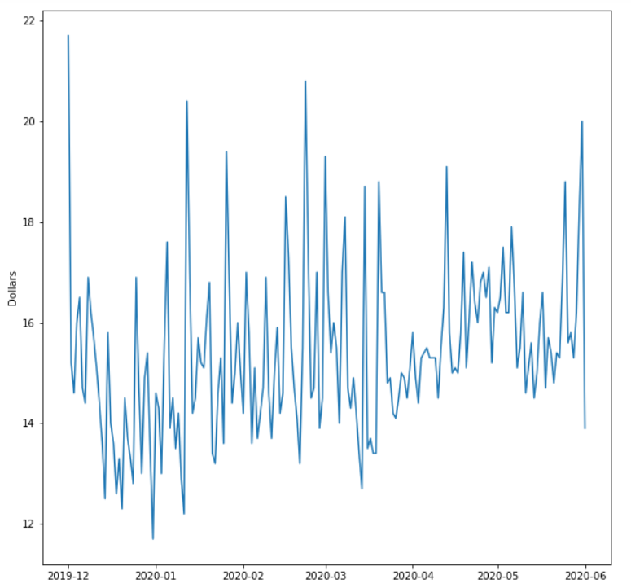
Average fare increased by $1
Notes:
https://www.wbez.org/stories/chicago-cab-drivers-face-impossible-situation-during-pandemic/bcc7ea0f-a14a-4e68-a662-b170cf89e544

Slide 12
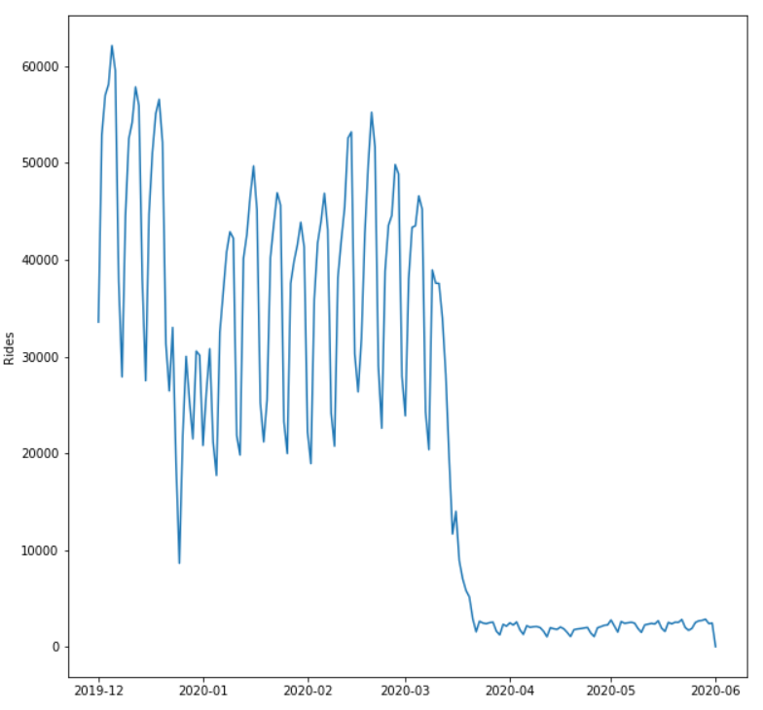
Daily taxi traffic dropped by ~95%

Slide 13
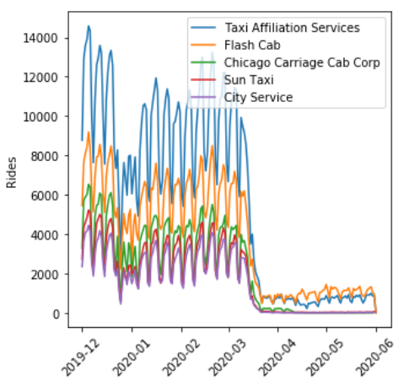
Major companies have the same trend

Slide 14
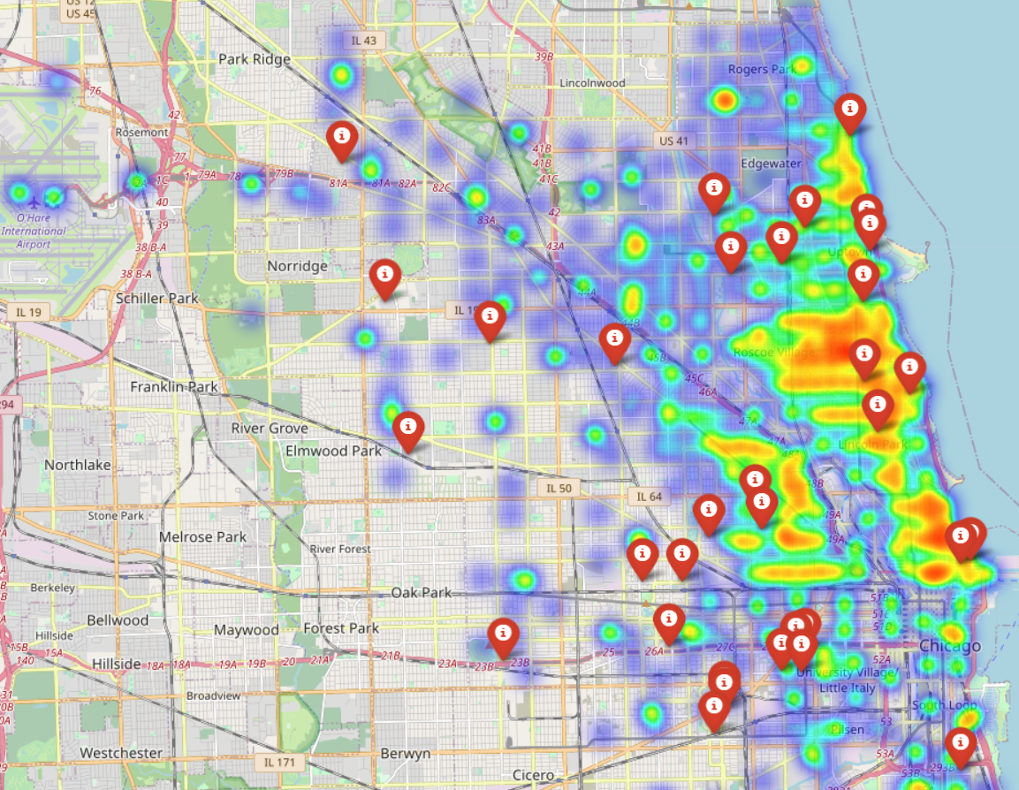
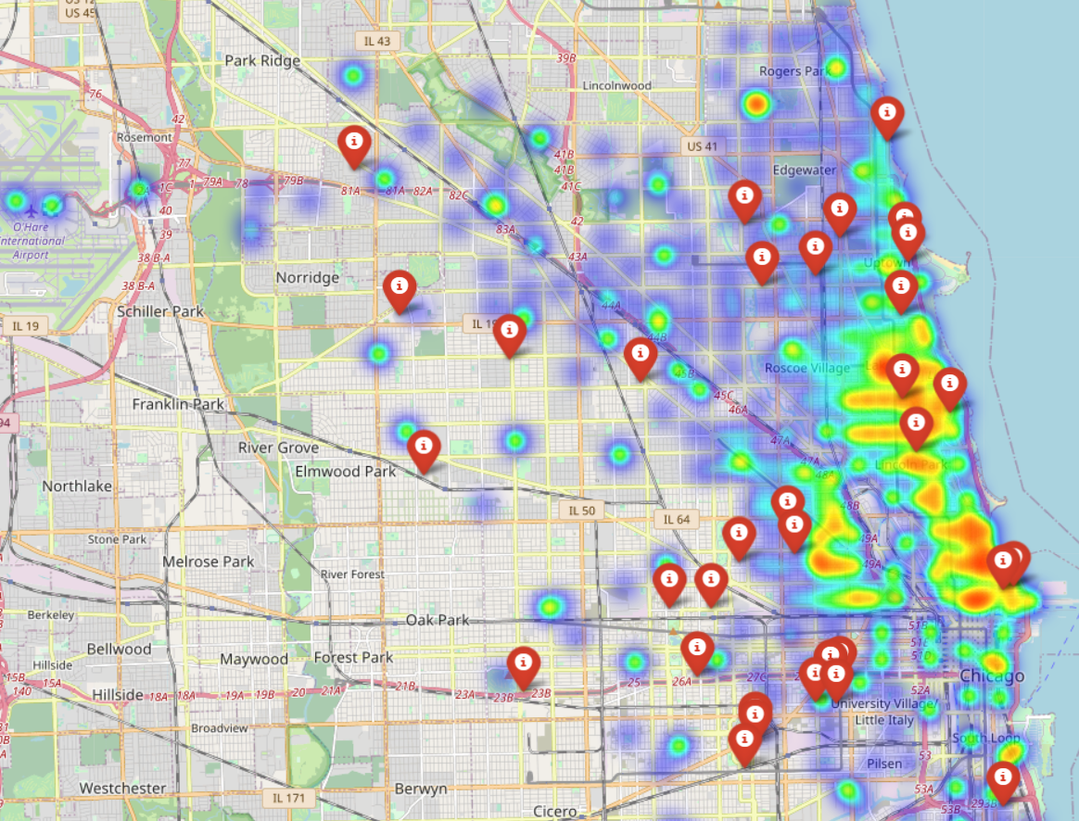
The intensity of rides decreased

Slide 15
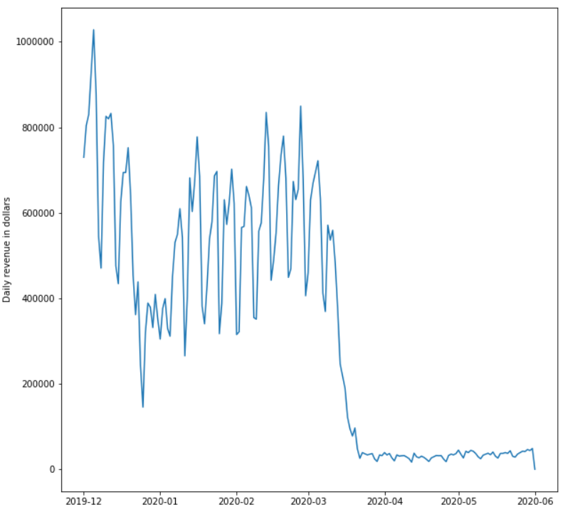
Total daily revenue down by ~95%

Slide 16
Hypothesis 2
COVID-19 changed the behavior of taxi clients
Average tipping amount went down
Notes:
So We'll know focus on customer behavior of taxi clients during COVID19 and try to understand the impact on their financial well being.

Slide 17
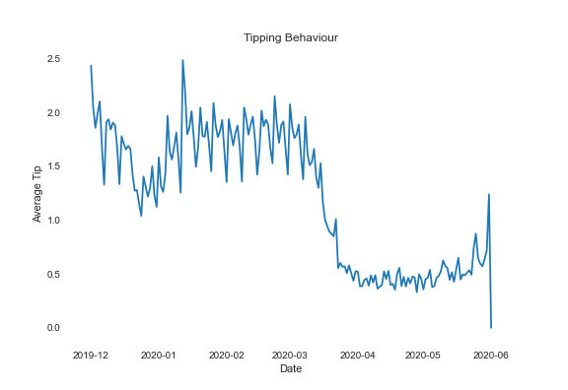
Average tip decreased from $2 to $0.5

Slide 18
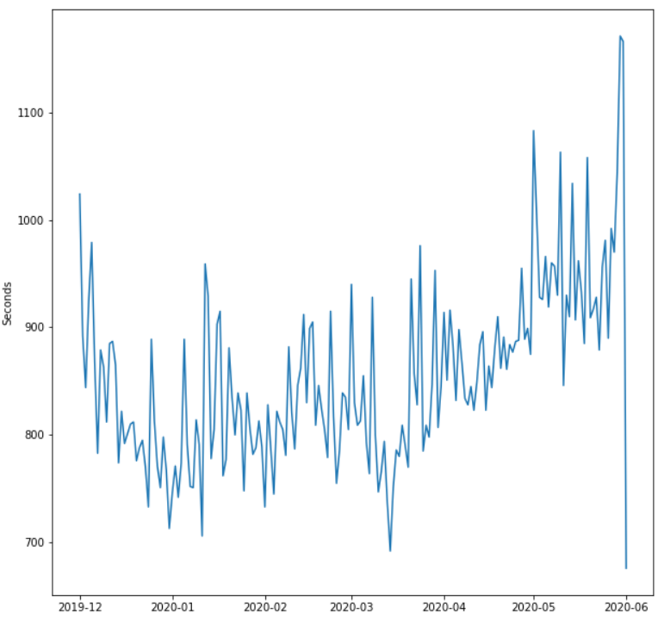
Average duration went up by 100 sec

Slide 19
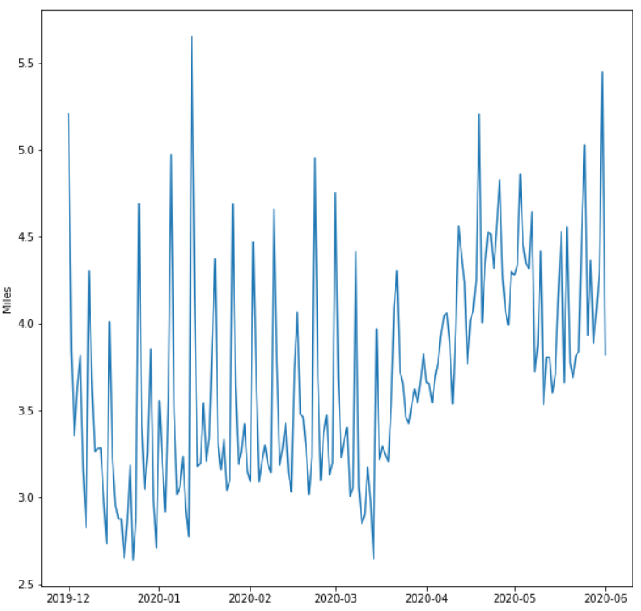
Average mileage went up by 0.7 mile

Slide 20
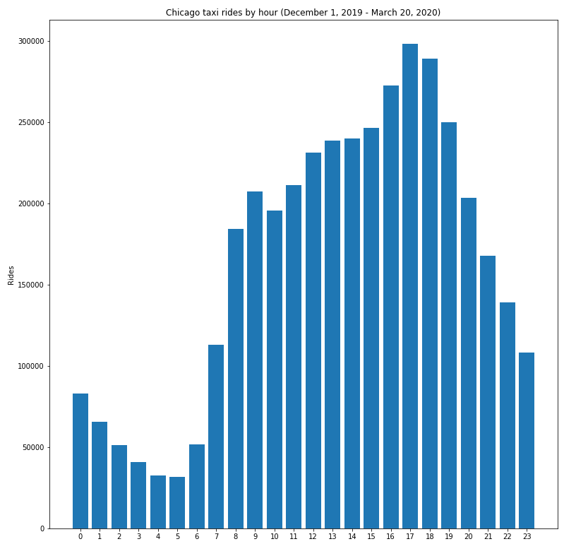
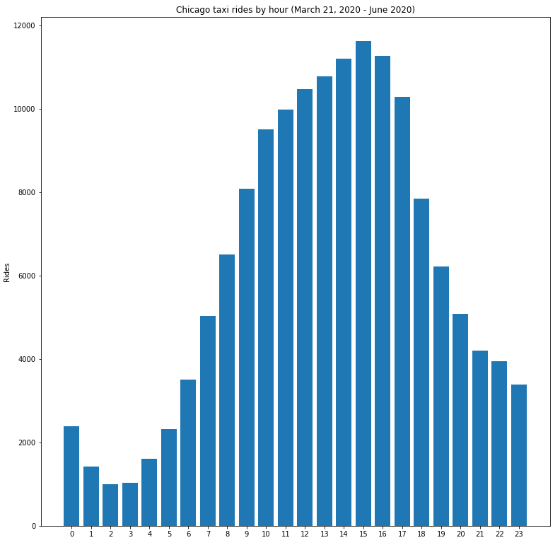
Clients change their hour preferences

Slide 21
Predicting tips (Logistic regression)
Taxi drivers in Chicago make between $31K and $46K
Tip is essential part of drivers' income (up to 40%)
Tips are frequently paid by cash and are not tracked
Notes:
The average Taxi Driver salary in Chicago is $38,000 which is actually lower than the Median household income over here.
In terms of earnings, they earn a total fare from their rides but have a lot of costs attached with it like a lease for taxi rental, share to the cab company, the cost of gas, etc.
Hence, Tips come out as an intangible item in their earnings accounting to 40% of their income because they are not held accountable for taxation purposes.
Which got us thinking about how their lives would have been impacted in the COVID19 scenario and if there was a way to understand customer behavior when it comes to tipping.

Slide 22


Model justification
Classification problem: Tip/No Tip
Boolean Values: 1 for Tips and 0 for No Tips
Solution: Multinomial Logistic Regression
Notes:
The key use case is to understand how customer behavior is changing in terms of tipping when their usual behavior in terms of miles, payment method,
and the fare is changing.
Our problem statement is a classification problem where if the person tips we get 1 and if they don't we get 0.
To model it we have used Multinomial Logistic Regression

Slide 23
Feature Engineering
Omit NAs (~0.03% of the whole dataset)
Dropped and added certain columns (location as long/lat & time)
Final dataset: 4135918 * 8
Notes:
Removed the NA values
Dropped time and location columns
we have done one-hot encoding for the categorical variables
and our final dataset is around 4 million rows

Slide 24
Model Engineering
Separate dataset: train (70%) & test (30%)
Variables : Seconds, Miles, Tolls, Fare & Payment Flag (bool)
Excluded from model: Tolls (based on low AIC values)
Notes:
We have randomly sampled our dataset into train i.e. 70% and test i.e. 30%.
We have first tried to create a full model i.e. fit the model with all the predictors being Seconds, Miles, Tolls, Fare & Payment Flag (bool) .
Then, We tried to reduce the model step by step by dropping the variables with low AIC values to come up with a reduced model.

Slide 25
Confusion Matrix
 | 0 | 1
FALSE | 608369 | 222
TRUE | 72038 | 560147
Notes:
Here, we have a matrix showing us true positives, true negatives, false positives, and false negatives.

Slide 26
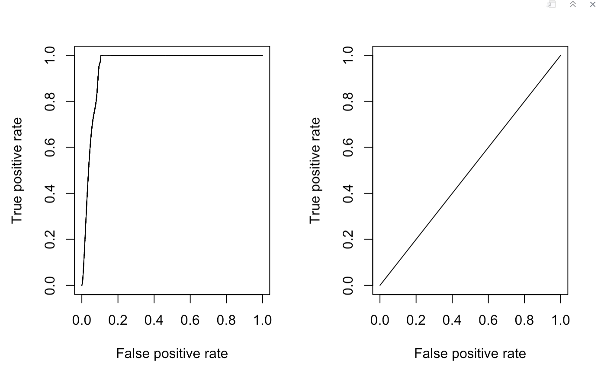
Model Validation – Comparing Models
AUC VALUE : 0.9554293
AUC VALUE : 0.5
Notes:
On the Right, we have the ROC curve for the Reduced model which has an AUC of 0.95 and on the left, we have a ROC curve for our Null mode which has a AUC of 0.5.

Slide 27

Time Series: Ideas and Challenges
Prophet is an open source science tool developed by the Data science team at Facebook for time series forecasting
Uses Generalized additive models which can be represented by ​
y(t) = g(t) + s(t) + h(t) + ϵ
Where​​
g(t)= models trend​​
s(t) = models seasonality​​
h(t)= models the effects of holidays​​
ϵ = error term​

Slide 28
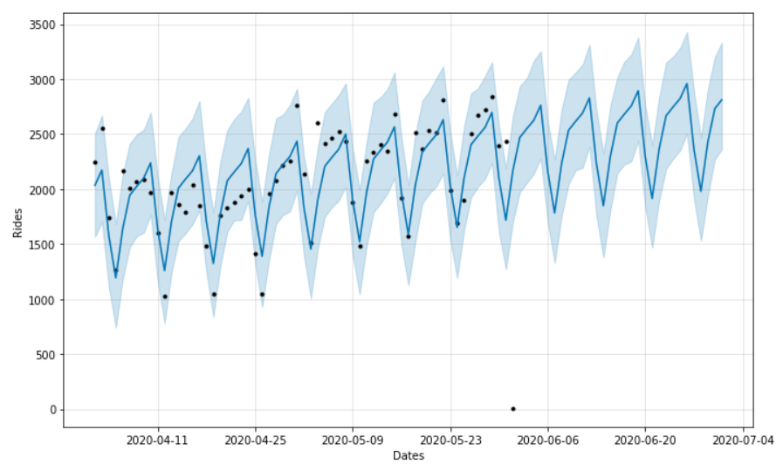
Slow 'New Normal' recovery during COVID

Slide 29
Hypotheses & Research Questions
Conclusions & Recommendations
Introduction
Analysis & Prediction

Slide 30
Summary
COVID-19 ruined the financial well-being of Chicago taxi drivers, their families and taxi companies' operations
Industry lost 95% of its previous traffic and revenues
Chicago taxi clients changed their behavioral during the crisis (mileage, hours, and tipping behavior)
Under current conditions the recovery will be slow

Slide 31



Policy Recommendations
Chicago authorities should reconsider the tax and fees burden on taxi drivers and companies
Drivers should be reimbursed for purchasing protective equipment
Companies should develop more flexible pricing and operations policies
Banks should offer drivers flexible payment mechanisms for car/other loan payments

Slide 32




MScA Advisors
Devanshi Verma
Co-Founder
Oleksiy Anokhin​
Co-Founder
Spring 2020 Cohort

Slide 33
References
GitHub Repository
https://github.com/OleksiyAnokhin/UChicago-COVID-Hackathon
https://github.com/thisisdevanshi/MSCA-Hackathon
YouTube Recording
www.bit.ly/uchicago-covid-hackathon-video
Chicago Open Data Portal
https://data.cityofchicago.org/Transportation/Taxi-Trips/wrvz-psew

Slide 34

Thank you for your time

